Slide 1
🛡️ CYBERSECURITY INCIDENT RESPONSE DRILL
Ransomware Incident Tabletop Exercise (TTX)
Off-Site Loan Officer Phishing, C2 Exfiltration & Active Encryption Response Scenario
• Turn-Key Facilitator & Player Presentation Deck
• SOP-Aligned RACI Authority & Escalation SLAs
• Multi-Department Response: SOC L1/L2/L3, CTI, IT Ops, Asset Owners & Executive Leadership

Slide 2
RANSOMWARE INCIDENT TABLETOP EXERCISE (TTX)
Executive Summary & Exercise Objectives
📌 Scenario Overview
• Vector: Remote Loan Officer receives Customer_Documents_2026.zip over Telegram.
• Execution: Trojan executable disguised as PDF triggers fake Adobe Error (0x80070005).
• Lateral Movement: Workstation reconnected to Corporate LAN; Active Directory enumerated.
• Exfiltration: 5GB sensitive customer loan archives siphoned to C2 185.123.45.6.
• Ransomlock: Workstation and network shares (\\FS01\LoanShares) encrypted with .lock extension.
• Demand: Attacker demands 5 Bitcoin ransom within 72 hours.
🎯 Core Objectives & Deliverables
• RACI Boundary Enforcement: Validate clear distinction between SOC L1, L2, L3, SOC Manager, Asset Owner, and CIO/CISO.
• Containment Velocity: Test SLA speeds (<15 min L1 escalation, <30 min host/network isolation).
• WAR Room Operations: Simulate Incident Communicator setup and executive notification streams.
• Business Recovery: Practice joint CIO & CISO return-to-production approval procedures.
• PIR & Lessons Learned: Review post-incident action tracking and long-term hardening.

Slide 3
RANSOMWARE INCIDENT TABLETOP EXERCISE (TTX)
11 Exercise Role Handbooks & RACI Responsibilities
🎭 SOC L1 Analyst
Scope: Shift Duty Triage
Monitor alerts, validate FP/TP, enrich context, ITSM ticket, escalate <15 min.
🎭 SOC L2 Analyst
Scope: Lead Investigator
Investigate scope, forensic log analysis, high-sev containment execution, draft report.
🎭 SOC Lead / L3
Scope: Senior Forensics
Deep malware analysis, RCA support, authorize major containment, SEV1 support.
🎭 Incident Communicator
Scope: Comms & WAR Room
Own WAR Room, notify Execs per SLA, interim reports (NO containment authority).
🎭 SOC Manager
Scope: Operational Authority
Declare Major Incident, approve major containment, engage BCP/DR, oversight.
🎭 Business / Asset Owner
Scope: Business Context
Assess business impact, approve prod containment, validate operational recovery.
🎭 Network & System Team
Scope: Infrastructure Ops
Execute firewall blocks, AD account locks, endpoint isolation, reimaging.
🎭 CTI Team
Scope: Threat Intelligence
Provide IOC enrichment, threat actor attribution, C2 campaign correlation.
🎭 CIO
Scope: Core System Authority
Final authority core system crisis, approve SEV1/2 return to production.
🎭 CISO
Scope: Cyber Governance
Strategic cyber oversight, regulatory notifications, mandatory recovery sign-off.
🎭 Executive Management
Scope: Board & Governance
CIO/CRO/CISO/Cyber Head provide executive risk & regulatory decision governance.

Slide 4
RANSOMWARE INCIDENT TABLETOP EXERCISE (TTX)
RACI Containment & Recovery Authority Matrix
Role Title | Focus Area | SOP Mandatory Core Responsibilities | Containment / Recovery Authority
SOC L1 Analyst | Shift Triage | Monitor alerts, validate FP/TP, enrich context, ITSM ticket, escalate <15 min. | Predefined Low/Med Playbook
SOC L2 Analyst | Lead Investigation | Scope validation, forensic log analysis, draft technical incident reports. | High Severity (per matrix)
SOC Lead / L3 | Senior Forensics | Deep malware analysis, RCA support, share full authority during SEV1. | Major Containment Authorized
Incident Communicator | Comms & WAR Room | Own WAR Room, notify Execs per SLA, interim & final incident reports. | ❌ NO Containment Authority
SOC Manager | Operational Auth | Declare Major Incident, approve major containment, engage BCP/DR. | Full Operational Approval
Business / Asset Owner | Business Context | Assess application impact, approve prod containment, validate restoration. | Production System Approval
Network & System Team | Infrastructure Ops | Execute firewall blocks, AD account changes, endpoint host isolation. | Technical Execution Only
CTI Team | Threat Intel | IOC enrichment, campaign correlation, threat actor attribution. | Intelligence Support Only
CIO | Core System Auth | Final authority core system crisis, approve SEV1 & SEV2 production recovery. | Final Recovery Sign-Off
CISO | Cyber Governance | Strategic response oversight, regulatory alignment, mandatory recovery sign-off. | Strategic & Recovery Sign-Off
Executive Management | Board Governance | CIO/CRO/CISO/Cyber Head provide executive risk & regulatory governance. | Strategic & Regulatory

Slide 5
RANSOMWARE INCIDENT TABLETOP EXERCISE (TTX)
Injects 1 & 2: Phishing Payload Arrival & LAN Reconnaissance
📍 Inject 1: Unsanctioned Telegram Payload (09:15 AM)
• Context: Loan Officer working off-site receives Customer_Documents_2026.zip on Telegram.
• Payload: Disguised Signed_Agreement.pdf executable extracts trojan spirit DLL.
• Symptom: Adobe Reader error 0x80070005 pops up. Employee ignores & closes app.
• Undercover Activity: User-level persistence established; C2 beaconing initiated.
• Role Focus (SOC L1): Continuous monitoring, FP vs TP validation, ITSM ticket creation, escalate to L2 < 15 min.
📍 Inject 2: Corporate LAN Reconnection (02:00 PM)
• Context: Employee returns to office and plugs LOAN-LAPTOP-042 into HQ LAN.
• Lateral Movement: Malware detects AD domain controller & enumerates Kerberos tokens.
• Targeting: Discovers accessible file shares (\\FS01\LoanShares) under j.smith.
• Role Focus (CTI Team): Track callback IPs, enrich IOCs, cross-reference campaign patterns.

Slide 6
RANSOMWARE INCIDENT TABLETOP EXERCISE (TTX)
Injects 3 & 4: Data Exfiltration & Active Ransomware Crisis
📍 Inject 3: 5GB Data Exfiltration (02:25 PM)
• Context: Attacker initiates 5GB compressed archive siphon to C2 IP 185.123.45.6.
• SIEM Alerts: Outbound HTTPS Traffic Spike + Abnormal SMB Read Volume on \\FS01.
• Role Focus (SOC L2): Lead investigation, confirm severity level, scope impact, timeline reconstruction.
📍 Inject 4: Active Encryption & HelpDesk Crisis (02:32 PM)
• Context: Ransomware component triggers! Local & \\FS01 files locked with .lock extension.
• Lock Screen: Red notice demands 5 BTC within 72 hours; workstation freezes.
• EDR Alert: CRITICAL SEV-1: Ransomware Execution Detected on LOAN-LAPTOP-042.
• Role Focus (SOC L3 & SOC Manager): Declare SEV-1 Major Incident & authorize major containment.

Slide 7
RANSOMWARE INCIDENT TABLETOP EXERCISE (TTX)
Injects 5 & 6: Incident Command WAR Room & Clean Recovery
📍 Inject 5: WAR Room & Multi-Team Containment (02:45 PM)
• WAR Room Setup: Incident Communicator establishes WAR Room & notifies CISO/CIO < 15 min.
• Network Containment: Network/System Team applies firewall block for 185.123.45.6.
• Identity Lock: Disable AD account j.smith & purge SMB Kerberos sessions.
• Production Guard: Business Owner approves \\FS01\LoanShares Read-Only isolation.
📍 Inject 6: Eradication, Clean Backup & Sign-Off (Days 2-3)
• Eradication: LOAN-LAPTOP-042 reimaged with hardened gold image & updated EDR.
• Restoration: File shares restored from clean immutable snapshot (98% validated).
• Business Sign-Off: Business Asset Owner confirms operational application readiness.
• Executive Blessing: Joint CIO & CISO sign-off mandatory for return-to-production.
• Post-PIR Enforcer: SOC Manager tracks overdue action items per 72-hr SLA.

Slide 8
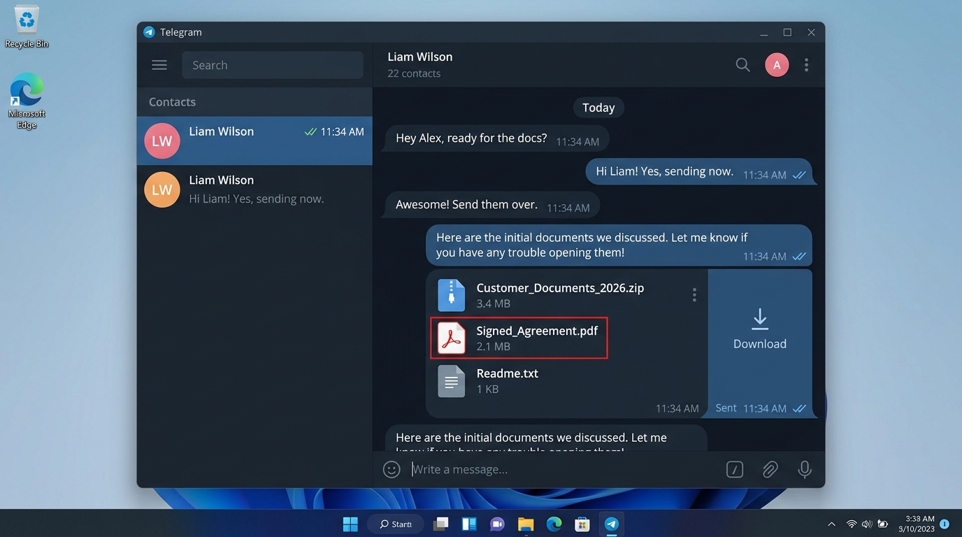
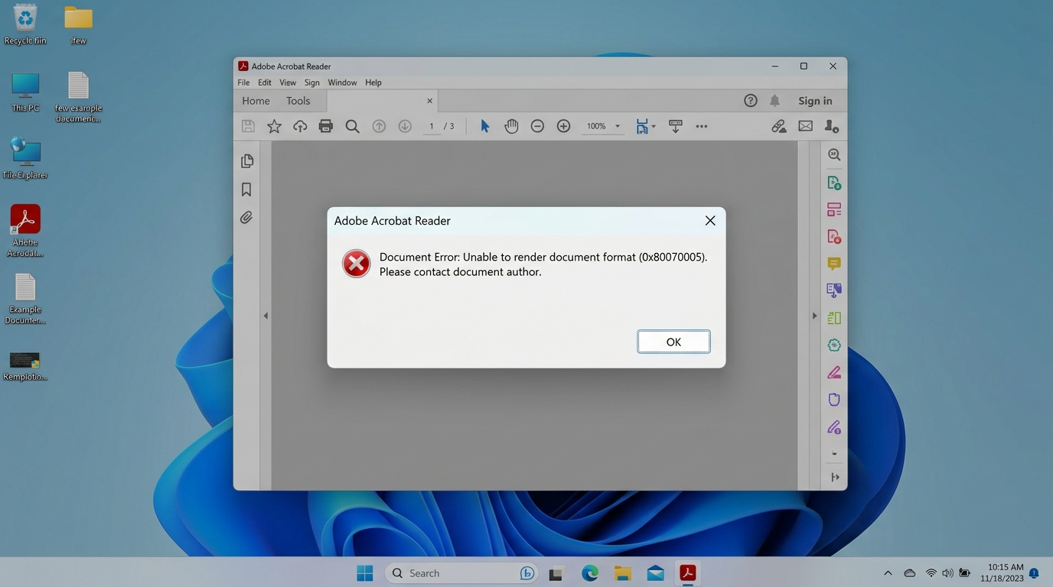
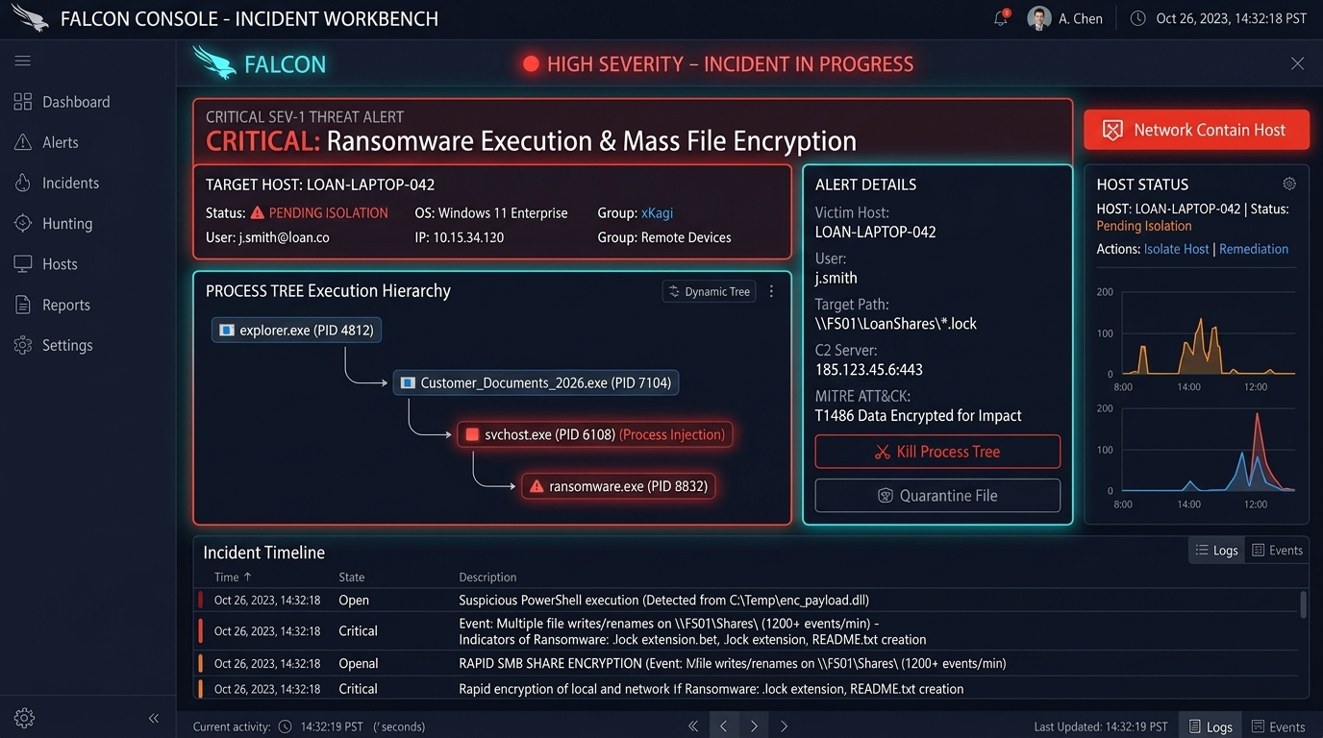
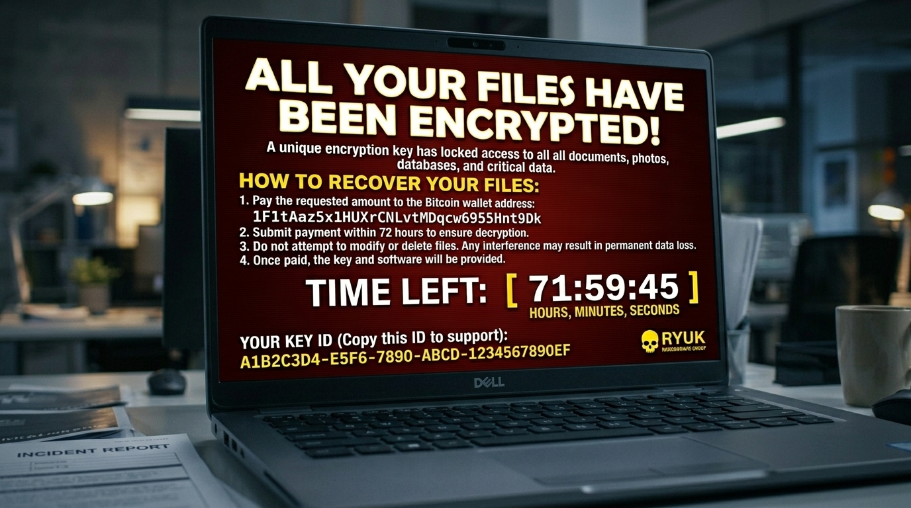
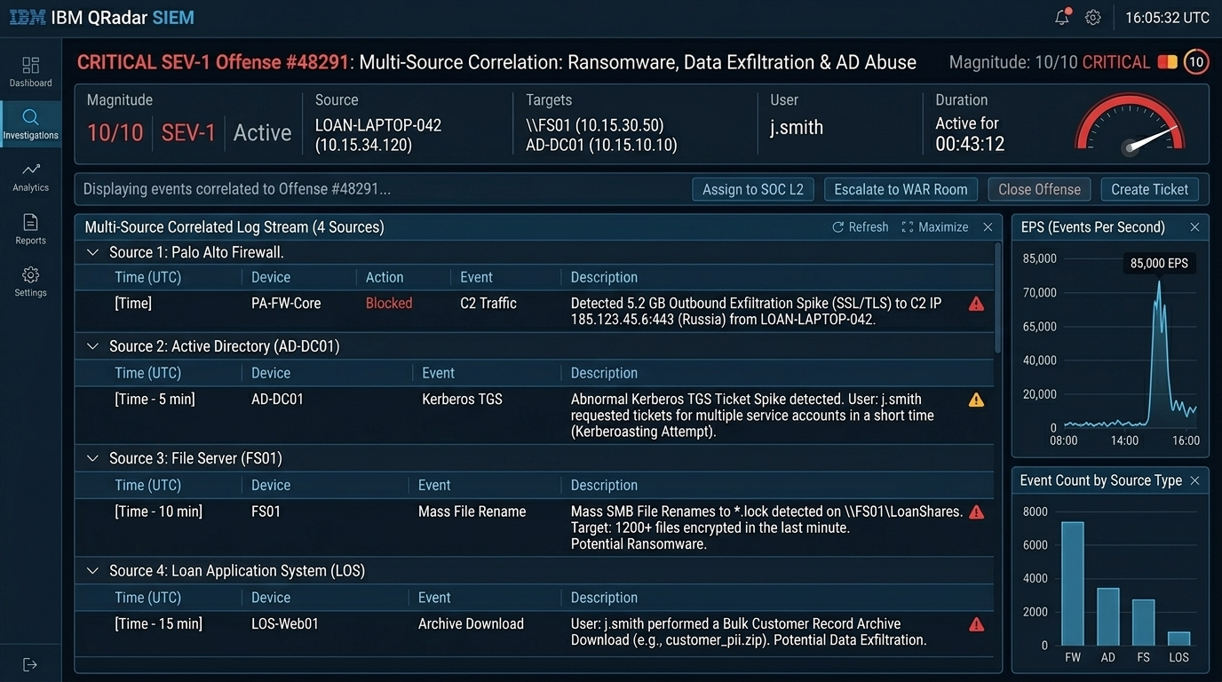
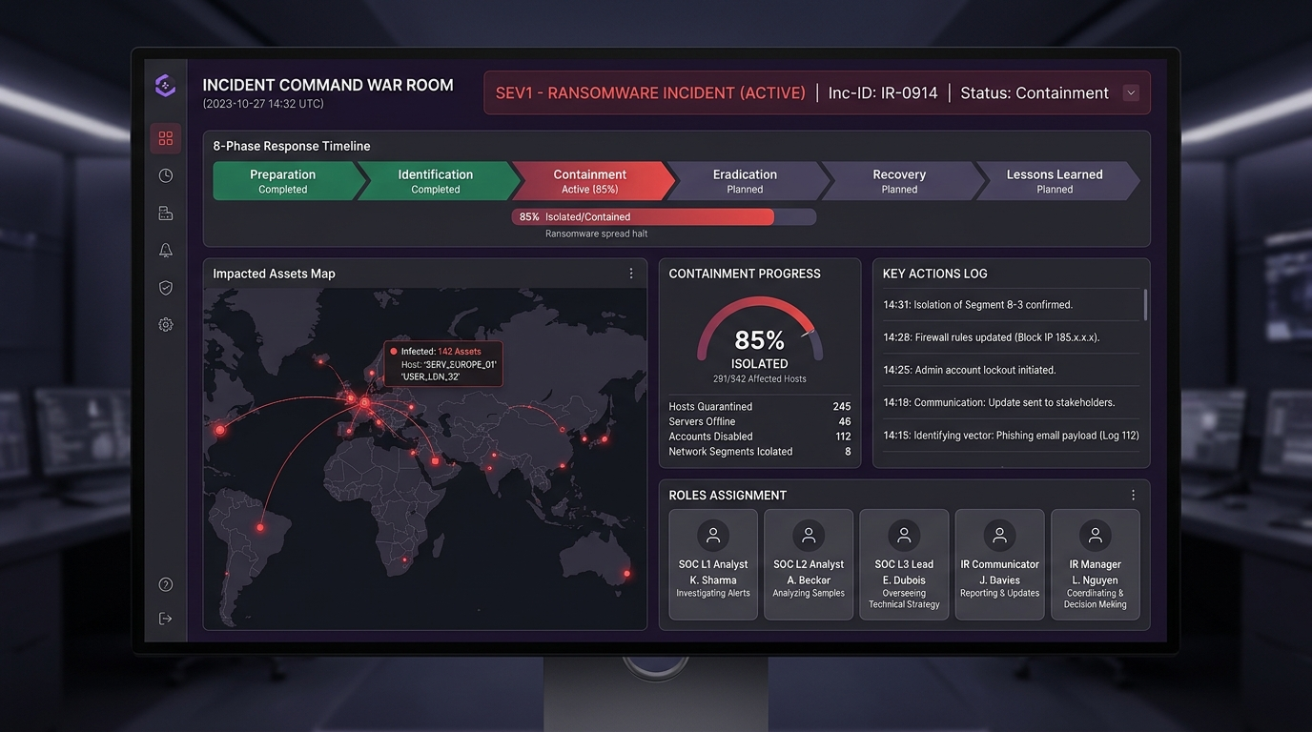
RANSOMWARE INCIDENT TABLETOP EXERCISE (TTX)
Visual Incident Assets & Threat Mockups Showcase
📸 Telegram Phishing Vector
📸 Fake Adobe Reader Error
📸 CrowdStrike EDR SEV-1 Alert
📸 Workstation Ransom Lock Screen
📸 SIEM Event Correlation
📸 Incident Command WAR Room

Slide 9
RANSOMWARE INCIDENT TABLETOP EXERCISE (TTX)
TTX Evaluation Rubric & Target Response SLAs
📊 Key Performance Indicators (KPIs) & SLA Benchmark
⏱️ L1 Alert Validation SLA (< 15 Min)
L1 validates True Positive state, enriches asset context, opens ITSM ticket, and escalates to L2 (or SOC Manager directly if L2 is unavailable).
⏱️ L2/L3 Containment Speed (< 30 Min)
L2 leads investigation; Network/System team executes host isolation, firewall C2 blocks, and AD account lockouts per RACI matrix.
⏱️ Executive Notification SLA (< 15 Min)
Incident Communicator notifies CISO, CIO, and Cybersecurity Division Head immediately upon SEV-1 confirmation.
⏱️ WAR Room Establishment (< 30 Min)
Central Incident Command WAR Room established with representatives active across all 11 defined role profiles.
⏱️ Clean Snapshot Restoration (< 4 Hours)
System engineers restore 98%+ clean file shares from immutable backups; Asset Owner verifies operational data integrity.
⏱️ Joint Executive Sign-Off (< 24 Hours)
Mandatory formal return-to-production approval granted by both CIO and CISO prior to incident closure.

Slide 10
RANSOMWARE INCIDENT TABLETOP EXERCISE (TTX)
Exercise Wrap-Up, PIR & Action Items
🚀 Post-Incident Review (PIR) & Action Plan
✔ Document Observations: Facilitator compiles evaluator notes and player responses into After-Action Report (AAR).
✔ Enforce Action Item Tracking: SOC Manager tracks assigned PIR recommendations with 30/60/90 day SLA deadlines.
✔ Harden Remote Workflows: Review Telegram / external chat policy & enforce automated sandbox attachment scanning.
✔ Refine Playbooks: Update Account Compromise & Ransomware Playbooks based on TTX findings.
✔ Portal & Slide Deck Deck Access: Access full interactive portal via index.html.

